Slide 1





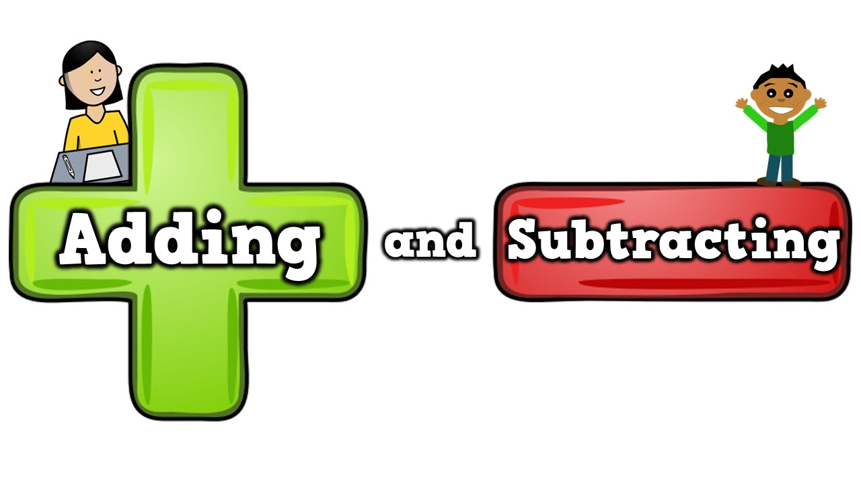
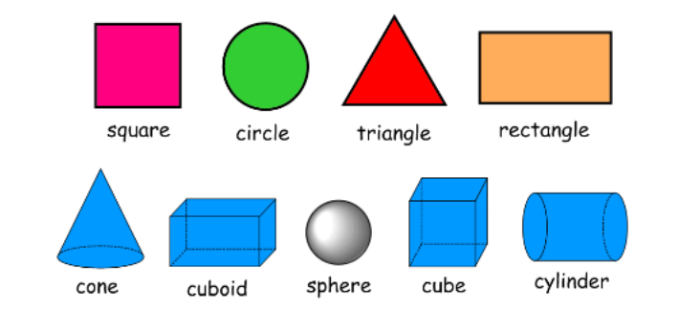
Year 1 Newsletter
Autumn 2—2024/2025
Notices and Reminders
Your child’s PE day is on Monday
Please ensure that your child’s PE kit contains:
- A Mytchett logo PE t-shirt or a plain t-shirt in the house colours
- Black shorts
- Black tracksuit top/ Grey Mytchett hoodie
- Black tracksuit bottoms
- Trainers (that fit!)
Please remember to take out your child’s earrings on PE days. Our school website shares guidance on the wearing of jewellery.
Key dates
Sat 9th Nov
FFMPS Fireworks Fiesta
WB - Monday 11th Nov Antibullying Week (inc. Odd socks day Tues)
Weds 20th Nov
Immunisations
Fri 29th Nov
SMILE Afternoon
Thursday 12th Dec
Carols by Candlelight – Y3 – Y6 (5.30pm)
Mon 16th Dec
KS1 Nativity – St Andrew’s Church Evening (6.00pm)
Tues 17th Dec
Christmas Jumper Day/Christmas Craft Day/FFMPS Shopping Day PT Elf Run
Weds 18th Dec
Christmas Lunch and Quiz
Thurs 19th Dec
Rock steady Concert (time tbc)
20th December
End of Term
1.30pm finish main school/1.15pm Nursery
Phonics
In phonics the children will be learning these Phase 5 sounds:
/or/ <au>, /ee/ <ey>, /ai/ <a-e>, /ee/ <e-e>, /igh/ <I-e>, /oa/ <o-e>, /oo/ /y+oo/ <u-e>, /s/ <c>, /ee/ <y>, and /or/ <al>.
They are learning to read the harder to read and spell words: please, once, any, many, again, who, whole, where, two.
Writing
This half term in writing, the children will be learning some stories by heart. They will then write them using their phonic knowledge before undertaking some simple editing.​
​
The texts the children will learn are:​
Supertato​
The Knight Who Wouldn’t Fight​
Maths
Over the half term, the children will continue their learning on addition and subtraction. They will use resources such as counters, tens frames and part-whole models to support their understanding of this.
The children will also learn how to recognise, name and sort 3D and 2D shapes. They will use this knowledge to help them with identifying and creating their own patterns.

Slide 2
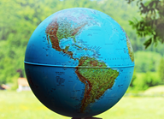
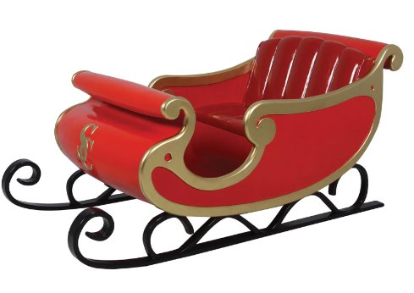
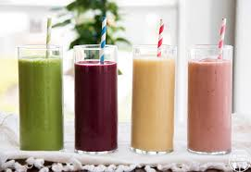






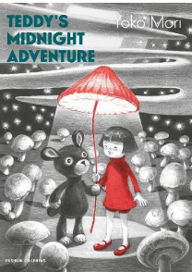
Science
This half term the children will be exploring different materials and comparing their properties. They will use terminology such as: transparent, opaque, hard, soft, rigid and flexible. The children will be carrying out an investigation about absorption. They will then use their knowledge about the properties of different materials to design a new sleigh for Father Christmas, giving scientific
reasons for our choices.
Geography
This half term in geography, the big question is 'What are the continents and oceans of the world?'. The children will be looking at globes and atlases to support their learning. They will then learn the names of the 7 continents and the five oceans of the world.
DT
This half term in DT, the children will be making fruit smoothies. They will start by learning all about fruits and vegetables, including how they grow. They will then learn how to prepare fruit safely, before using a recipe to make their own fruit smoothies.
PE
This half term, the children will be dancing their way through PE! They will be learning how to travel safely from one place to another, jumping and balancing. They will then be learning dance sequences using a series of movements to some awesome songs!
Computing
This half term in computing, the children will be learning what technology is as well as how to use it safely and successfully. There will be a focus on how to 'smile' and stay safe when using technology.
PSHE​
The children will be learning how to stay healthy this half term. They will be looking at what a healthy diet is and sorting healthy and less healthy foods. They will then be thinking about how to keep their bodies and minds healthy. They will be focusing on things they can do to help their minds stay happy and healthy.
Homework
Reading everyday where possible.
Suggested books for reading

